Slide 1
MATH2010 Probability and STATISTICS
Le DUY DUNG
College of Engineering and Computer Science

Slide 2

Invited Lecture 1
Dr. Aghiles Salah
Research Scientist in Machine Learning at Rakuten Institute of Technology
https://saghiles.github.io/

Slide 3

Invited Lecture 2
Mr. Vu Quoc Uy (Daniel Wu)
M.Sc. in Actuarial Science (Soongsil University)
Vice President of Research at WorldQuant
https://www.linkedin.com/in/daniel-wu-a9112859/

Slide 4


Quiz 4 will happen on Wed, Oct 20, 2021
Happy Vietnamese Women’s Day 20/10!

Slide 5
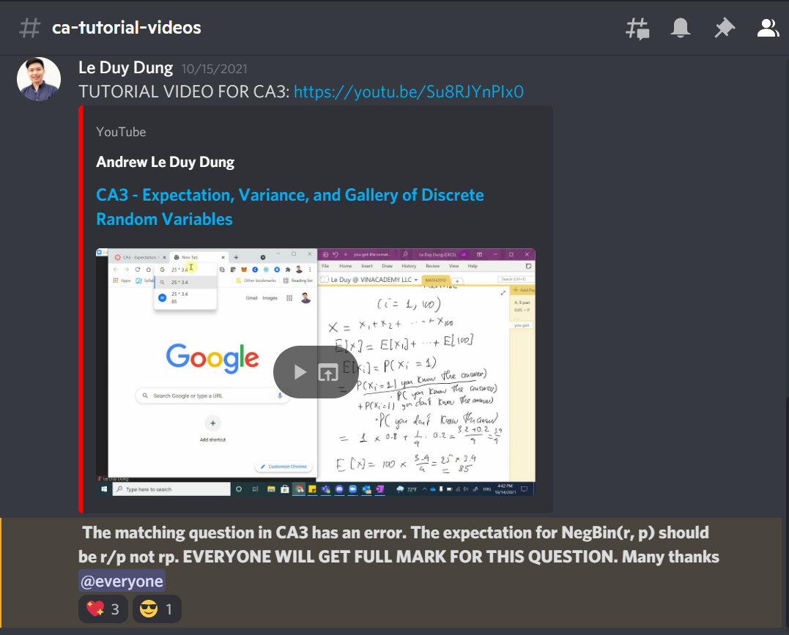
You Might Have Missed - #ca-tutorial-videos

Slide 6
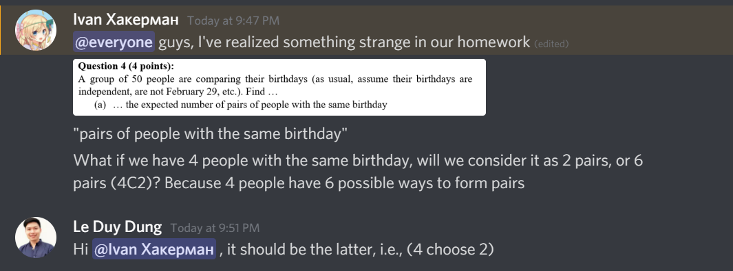
You Might Have Missed - #problem-sets-Help

Slide 7


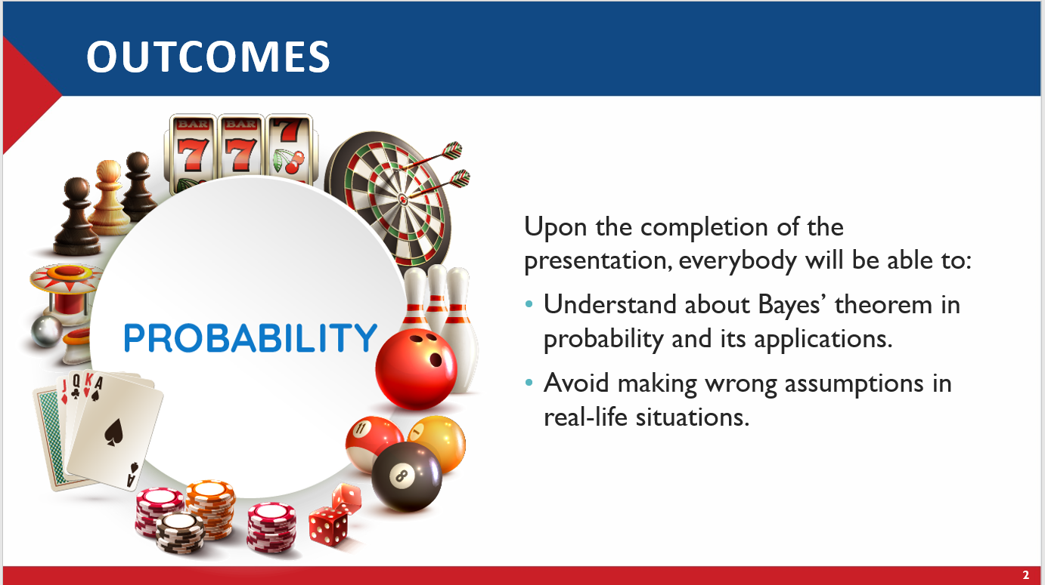
You Might Have Missed - #GENERAL

Slide 8

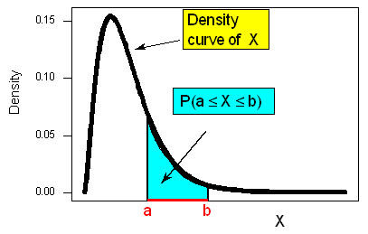
From Lectures 7+8

Slide 9
Learning GOALS
STANDARDIZING RANDOM VARIABLES
THE NORMAL/GAUSSIAN RANDOM VARIABLE
CLOSURE PROPERTIES OF THE NORMAL RANDOM VARIABLE
THE STANDARD NORMAL CDF

Slide 10

THE GALTON BOARD

Slide 11
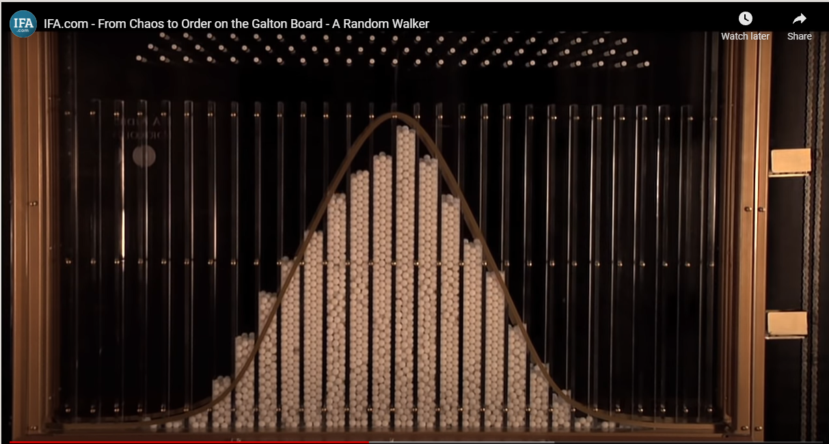

Slide 12


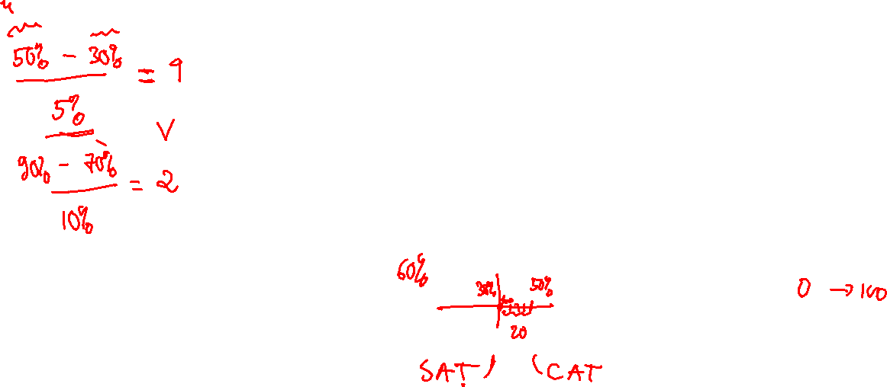
History vs. MATH
Your score:
90%
50%
Mean:
70%
30%
Standard Deviation:
10%
5%

Slide 13
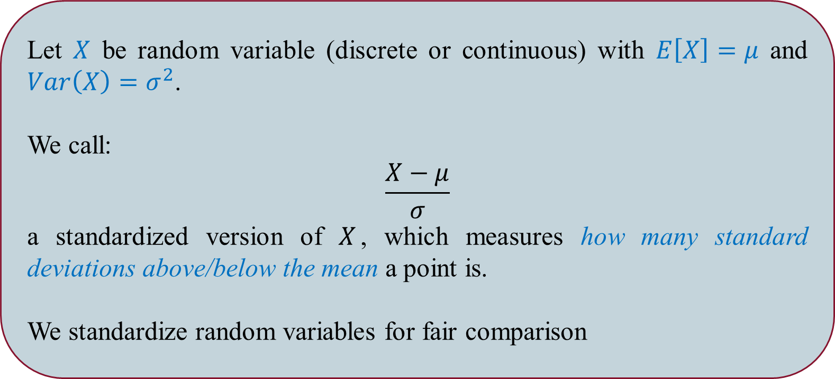
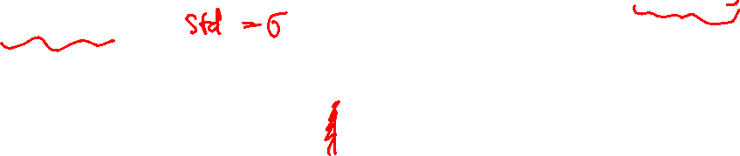
Standardizing Random Variables
Let $X$ be random variable (discrete or continuous) with $E\left[X\right]=μ$ and $Var\left(X\right)=σ^{2}$.
We call:
$$\frac{X−μ}{σ}$$
a standardized version of $X$, which measures how many standard deviations above/below the mean a point is.
We standardize random variables for fair comparison

Slide 14
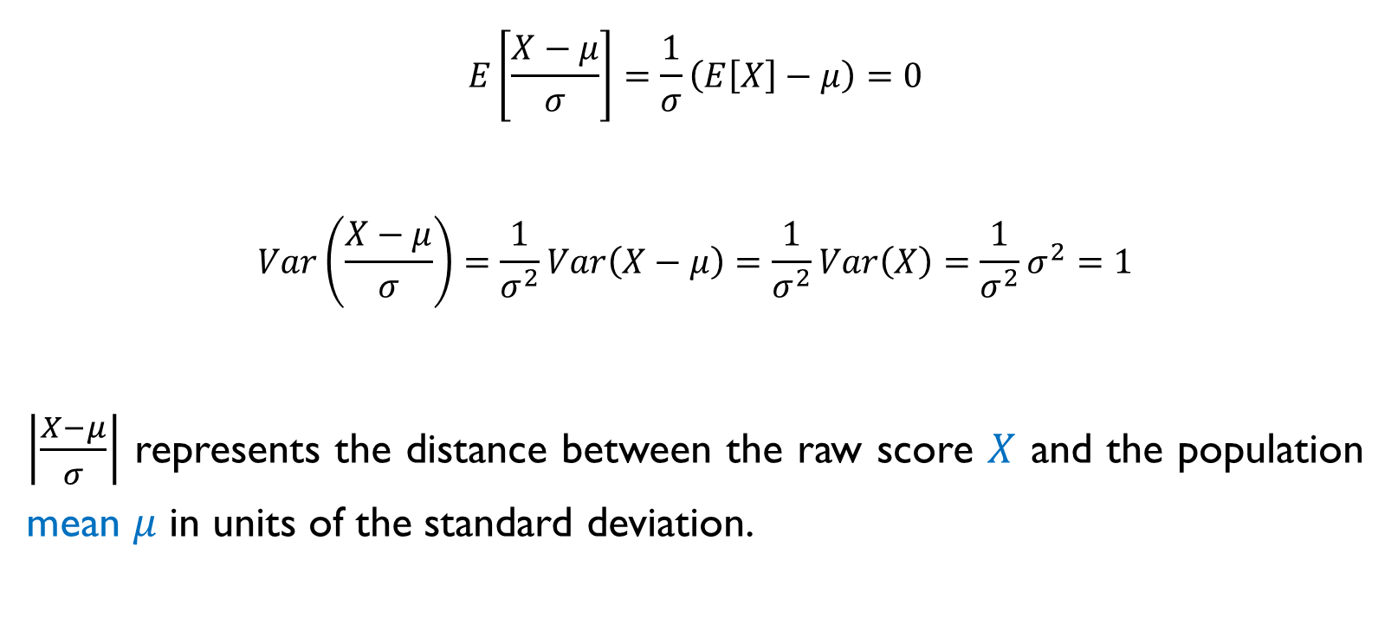
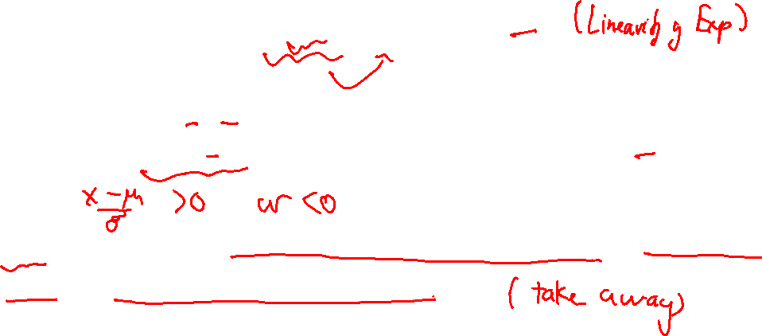
Standardizing Random Variables
$$E\left[\frac{X−μ}{σ}\right]=\frac{1}{σ}\left(E\left[X\right]−μ\right)=0$$
$$Var\left(\frac{X−μ}{σ}\right)=\frac{1}{σ^{2}}Var\left(X−μ\right)=\frac{1}{σ^{2}}Var\left(X\right)=\frac{1}{σ^{2}}σ^{2}=1$$
$\left|\frac{X−μ}{σ}\right|$ represents the distance between the raw score $X$ and the population mean $μ$ in units of the standard deviation.

Slide 15
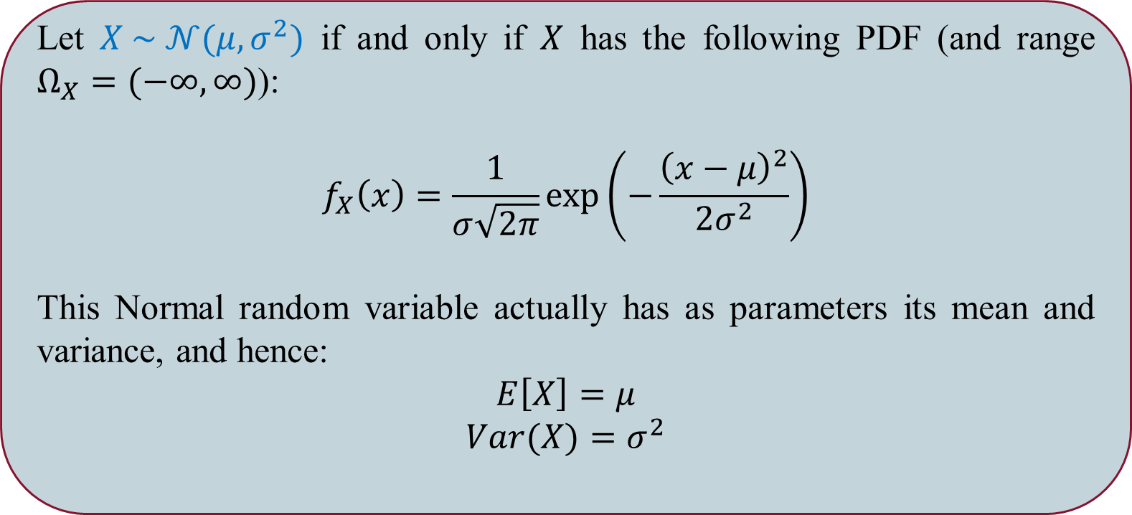

The Normal/Gaussian Random Variable
Let $X \sim 𝒩(μ, σ^{2})$ if and only if $X$ has the following PDF (and range $Ω_{X}=(−∞, ∞)$):
$$f_{X}\left(x\right)=\frac{1}{σ\sqrt{2π}}\exp\left(−\frac{{\left(x−μ\right)}^{2}}{2σ^{2}}\right)$$
This Normal random variable actually has as parameters its mean and variance, and hence:
$$E\left[X\right]=μ$$
$$Var(X)=σ^{2}$$

Slide 16
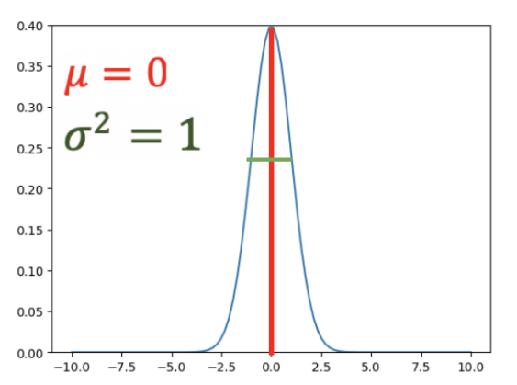
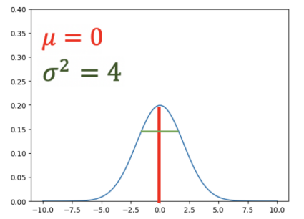
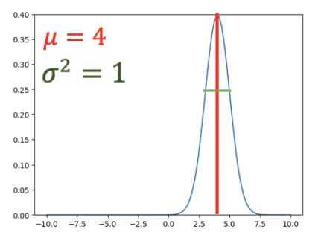
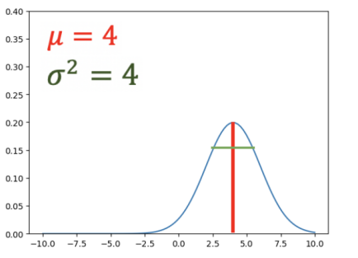
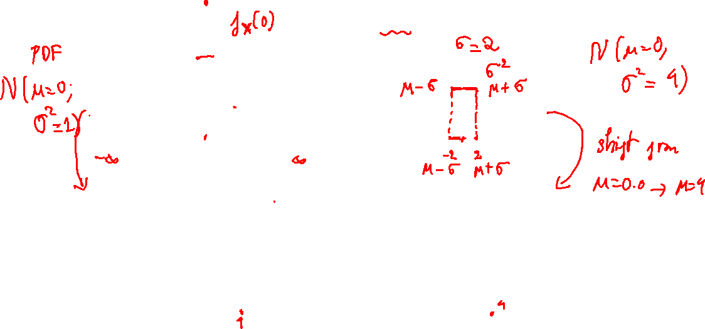

Slide 17
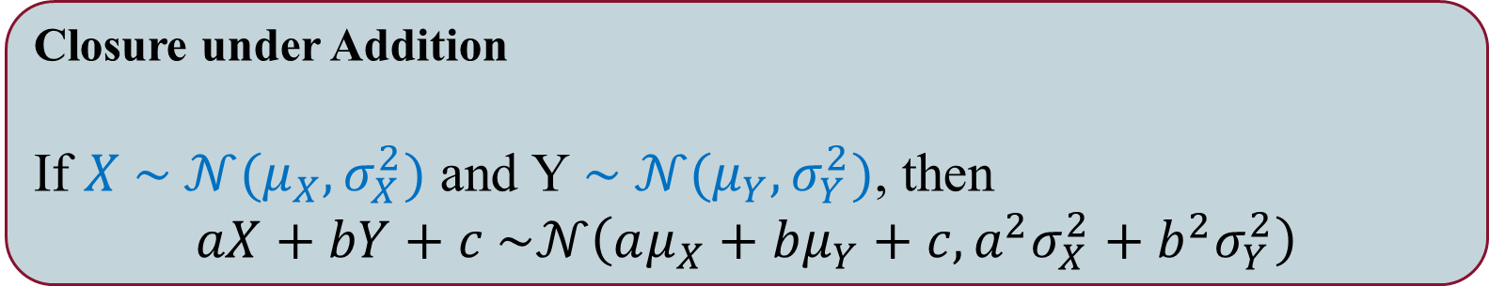
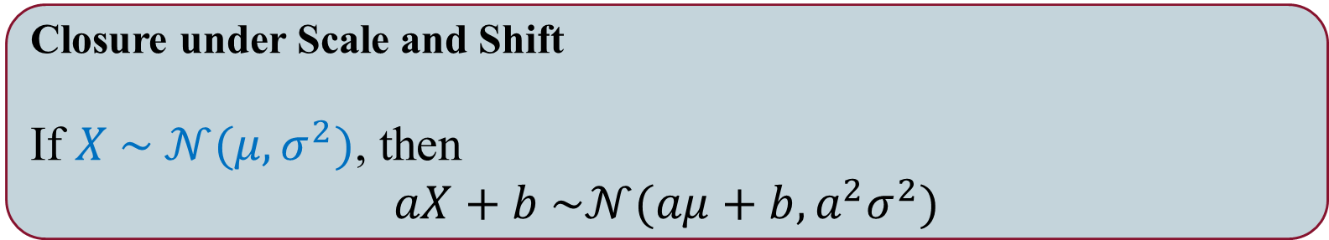
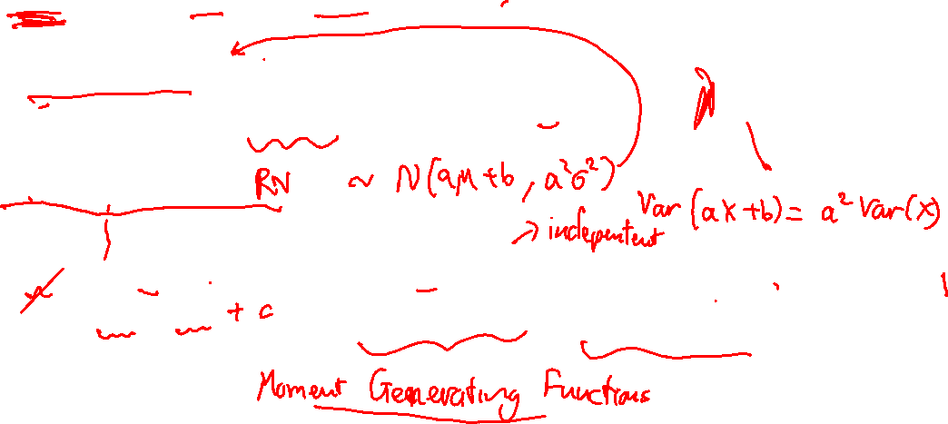
Closure Properties of the Normal Random Variable
Closure under Scale and Shift
If $X \sim 𝒩(μ, σ^{2})$, then
$$aX+b \sim 𝒩(aμ+b, a^{2}σ^{2})$$
Closure under Addition
If $X \sim 𝒩(μ_{X}, σ_{X}^{2})$ and Y$\sim 𝒩(μ_{Y}, σ_{Y}^{2})$, then
$$aX+bY+c \sim 𝒩\left(aμ_{X}+bμ_{Y}+c, {a^{2}σ}_{X}^{2}+{b^{2}σ}_{Y}^{2}\right)$$

Slide 18
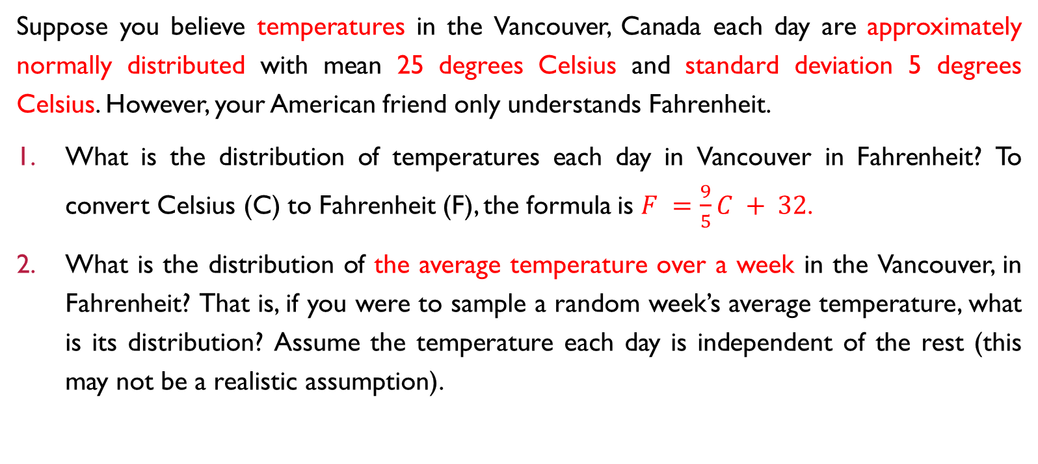
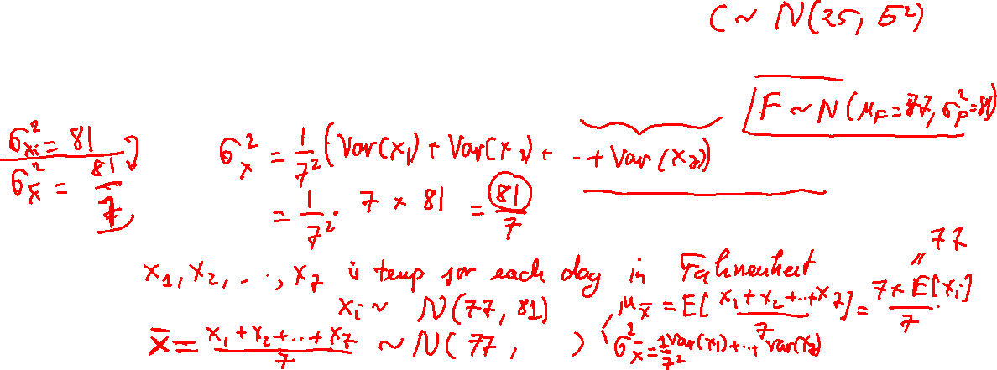
Suppose you believe temperatures in the Vancouver, Canada each day are approximately normally distributed with mean 25 degrees Celsius and standard deviation 5 degrees Celsius. However, your American friend only understands Fahrenheit.
What is the distribution of temperatures each day in Vancouver in Fahrenheit? To convert Celsius (C) to Fahrenheit (F), the formula is $F =\frac{9}{5}C + 32$.
What is the distribution of the average temperature over a week in the Vancouver, in Fahrenheit? That is, if you were to sample a random week’s average temperature, what is its distribution? Assume the temperature each day is independent of the rest (this may not be a realistic assumption).

Slide 19
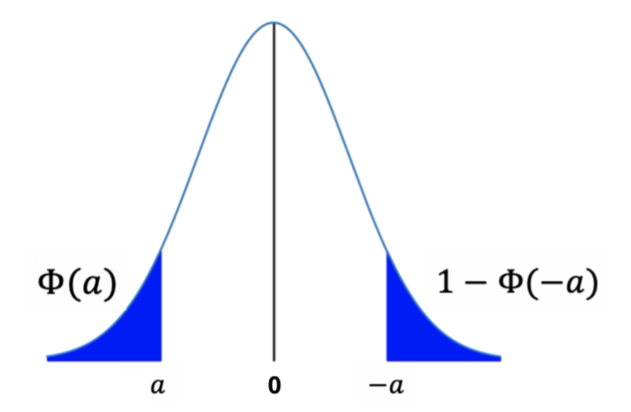
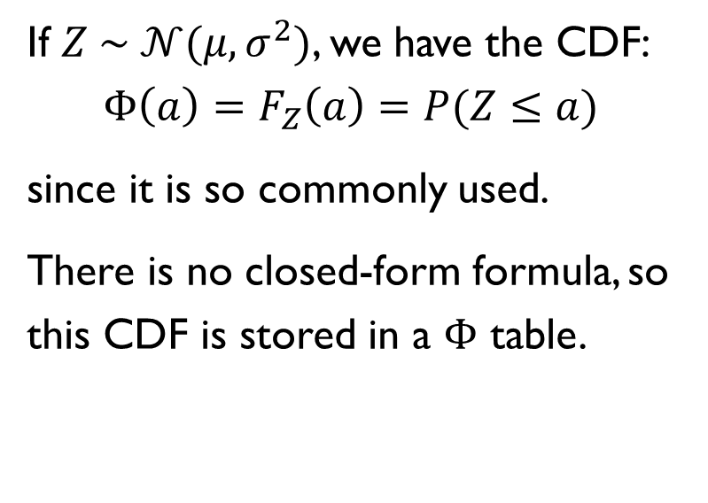
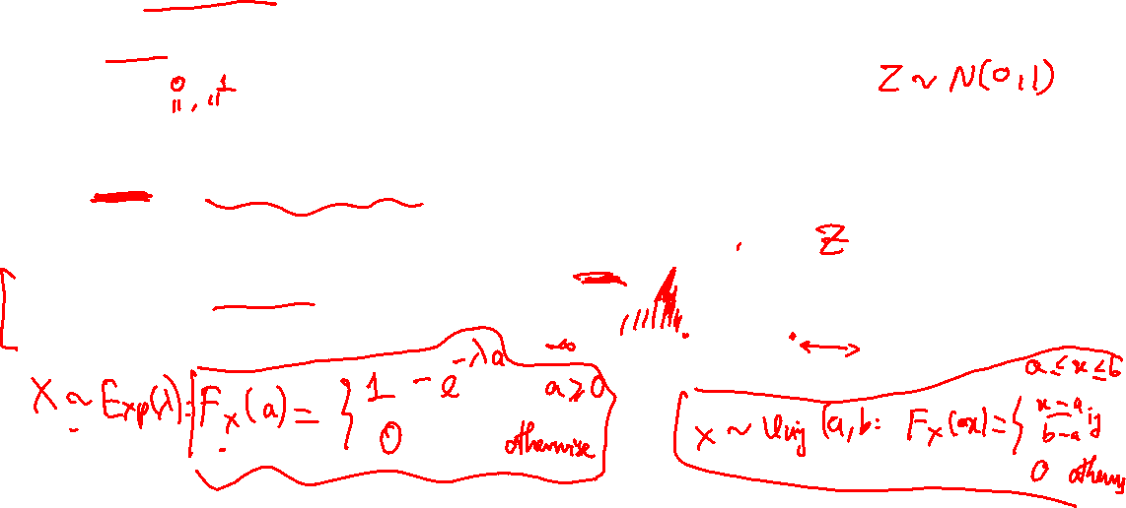
The STANDARD NORMAL CDF
If $Z \sim 𝒩(μ, σ^{2})$, we have the CDF:
$$Φ\left(a\right)=F_{Z}\left(a\right)=P(Z≤a)$$
since it is so commonly used.
There is no closed-form formula, so this CDF is stored in a $Φ$ table.

Slide 20
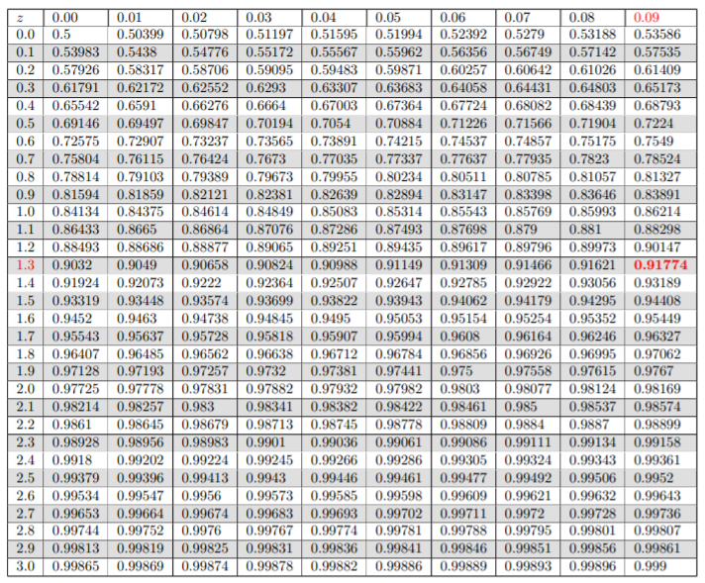
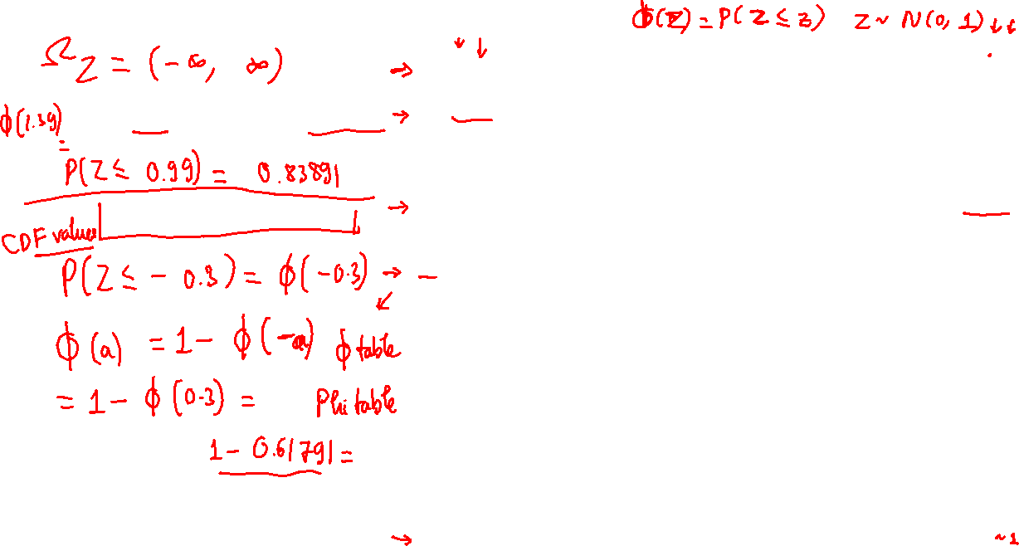
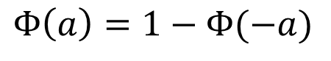
The STANDARD NORMAL CDF
$$P\left(Z≤1.39\right)=Φ\left(1.39\right)\sim 0.91774$$
$$Φ\left(a\right)=1−Φ(−a)$$

Slide 21
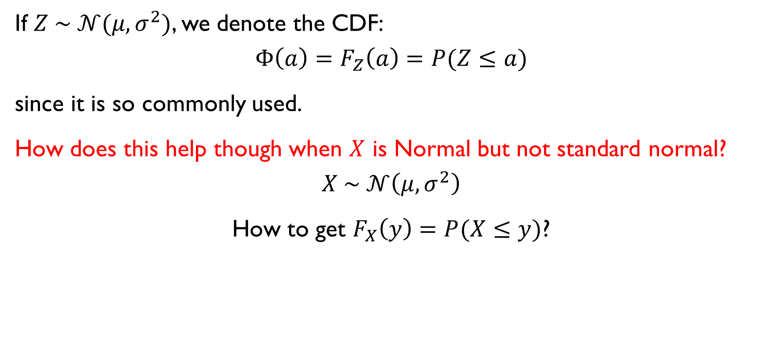
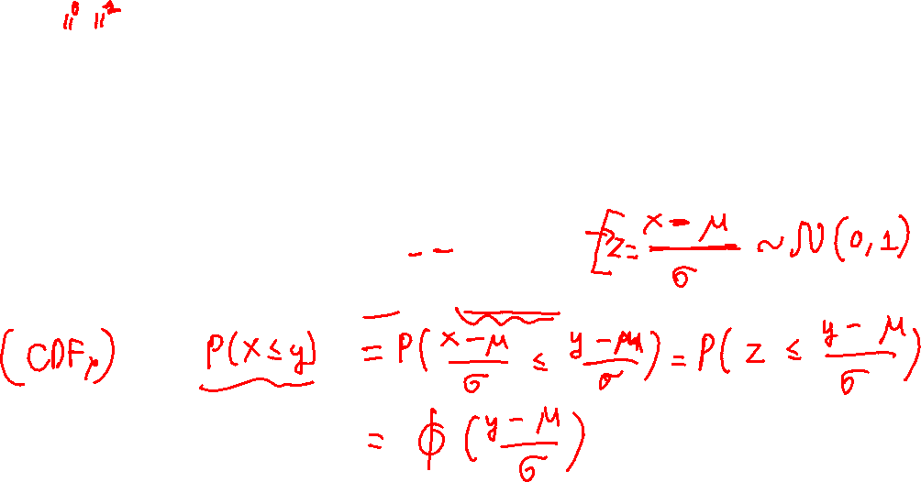
The STANDARD NORMAL CDF
If $Z \sim 𝒩(μ, σ^{2})$, we denote the CDF:
$$Φ\left(a\right)=F_{Z}\left(a\right)=P(Z≤a)$$
since it is so commonly used.
How does this help though when $X$ is Normal but not standard normal?
$$X \sim 𝒩\left(μ, σ^{2}\right)$$
How to get $F_{X}\left(y\right)=P(X≤y)$?

Slide 22
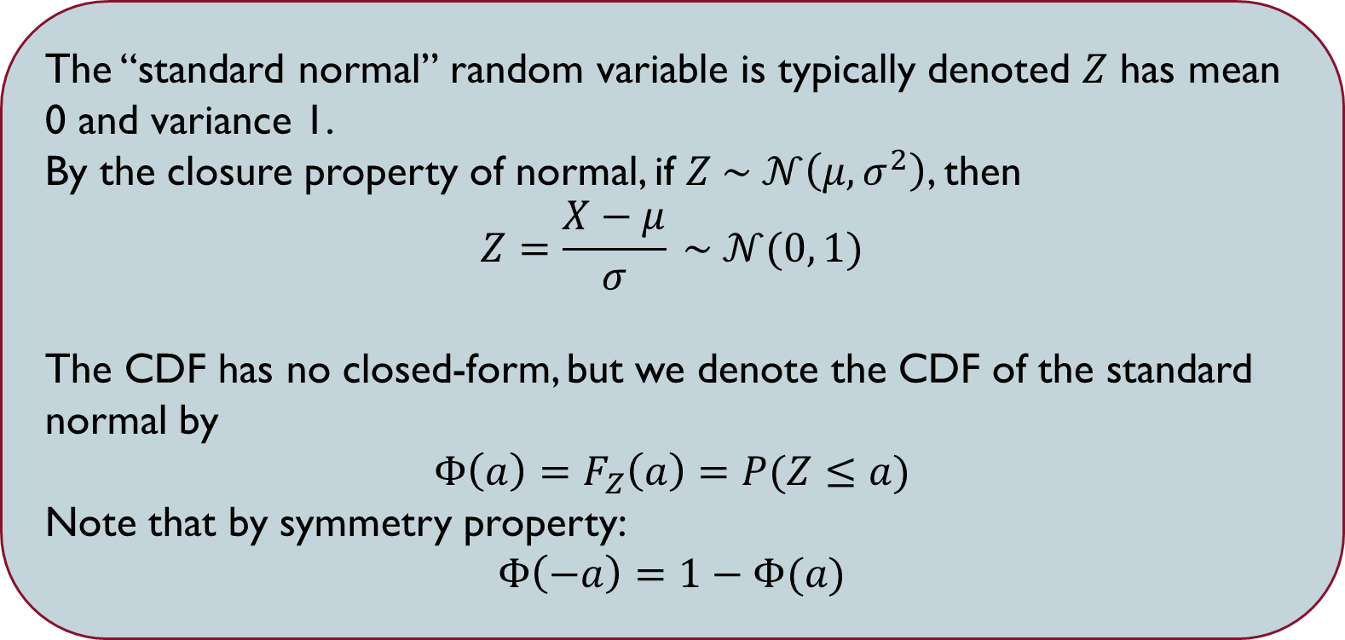
STANDARD NORMAL RANDOM VARIABLE
The “standard normal” random variable is typically denoted $Z$ has mean 0 and variance 1.
By the closure property of normal, if $Z \sim 𝒩\left(μ, σ^{2}\right)$, then
$$Z=\frac{X−μ}{σ} \sim 𝒩(0, 1)$$
The CDF has no closed-form, but we denote the CDF of the standard normal by
$$Φ\left(a\right)=F_{Z}\left(a\right)=P(Z≤a)$$
Note that by symmetry property:
$Φ\left(−a\right)=1−Φ(a)$

Slide 23
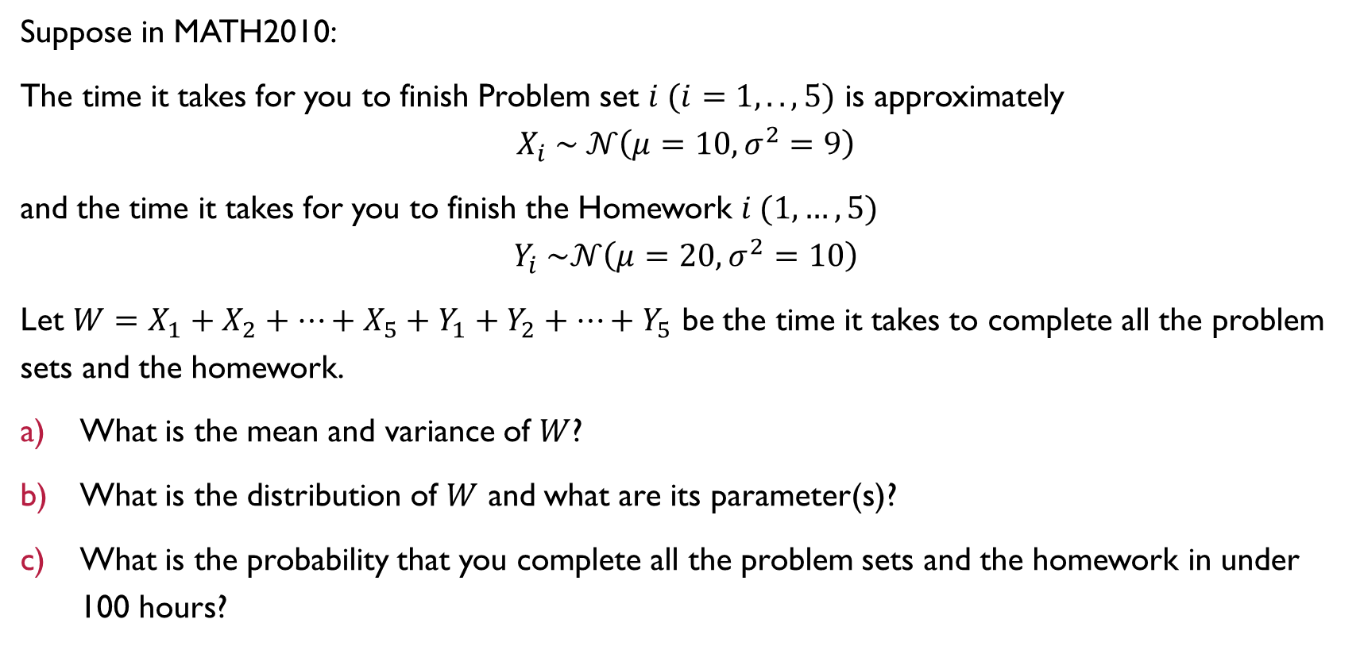
Example
Suppose in MATH2010:
The time it takes for you to finish Problem set $i (i=1, .., 5)$ is approximately
$$X_{i} \sim 𝒩\left(μ=10, σ^{2}=9\right)$$
and the time it takes for you to finish the Homework $i (1,…,5)$
$$Y_{i} \sim 𝒩\left(μ=20, σ^{2}=10\right)$$
Let $W=X_{1}+X_{2}+…+X_{5}+Y_{1}+Y_{2}+…+Y_{5}$ be the time it takes to complete all the problem sets and the homework.
What is the mean and variance of $W$?
What is the distribution of $W$ and what are its parameter(s)?
What is the probability that you complete all the problem sets and the homework in under 100 hours?

Slide 24
SUMMARY

Slide 26

Show-n-Tell This WEEK
Title: Application of probability on building a language model.
Description: The language model is the central concept in natural language processing and it's the most important building block for many applications such as machine translation, text classification, and question answering. However, the concept of the language model relies on a very simple idea in probability theory. In this presentation, we will discuss how probability is applied in language models and how we use language models in real-world applications.
by
MAI QUANG TUAN

